Slide 1
TLC quantum PROGRESS Meeting
Fontys

Slide 2
Agenda
Recap
Sprint 1 progress
Sprint 2 goals

Slide 3
Recap
Introduction
First meeting
Game afternoon at TU/E
Quantum chess
Login credentials
Wireframes
First design

Slide 4
Sprint 1 progress
Finetuned wireframes
Analysis and Documentation
Updated the wireframes
Started setting up the front-end
Project plan
Front-end research
User stories

Slide 5
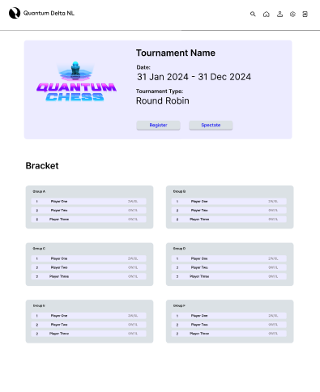
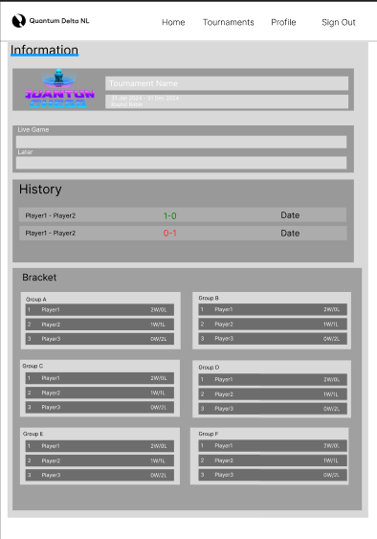
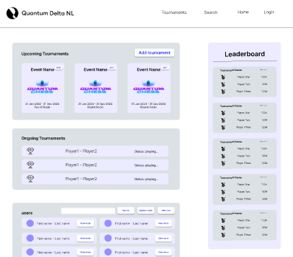
Updated wireframes

Slide 6
Analysis and documentation
Project plan
Research front-end
User stories
Reviewed and updated (Internally)
Reviewed by team
Send for review (externally)

Slide 7
User stories
Define sprint goals
Review user stories
Based on user stories we define sprint goals
Based on your review we know whether you want the features and how important they are to you

Slide 8
GOALS FOR NEXT sprint
Next Sprint Goals
Back-end research
Reviewed and finalized user stories
Front-end
Create basic clickable front-end
No functionalities yet
Back-end
Setting up environment
Creating database
Next Progress Meeting: March 28th

Slide 9
Thank You

